Slide 1

Spotify Project
Presented By: Jennifer Noga Davinroy, Micah Lewis, Simon Murray, Kelsey Traeger

Slide 2
Project Background
Goal: Show trends in music over time using interactive visualizations
Data Sources: Spotify API, Lyrics Genius API, and Billboard Music Charts API
Areas of interest:
Song lyrics
Song titles
Music categories
Music features

Slide 3
Data
Categories Table
Source: Billboard API
Year: current charts
Data: Top 40 songs by category with song rank, title, and artist
Categories: Greatest of all time, Pop, Country, Rock, Alternative, R&B/ Hip hop, Dance/electronic, and Latin
Top 10 Songs Table
Source: Billboard API, Lyric Genius API, and Spotify API
Years: 2006-2023
Data: Top 10 songs by year with rank, title, artist, lyrics, and music features
Music Features: Popularity, Danceability, Energy, Tempo, Duration (removed)

Slide 4
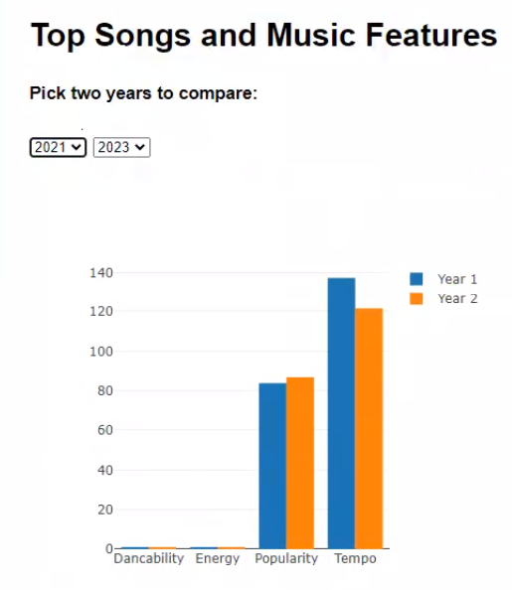
Music Features
Data
Data was taken from the top ten table.
Top 10 songs for the two chosen years.
Data visualization
Plotly bar chart of music features
Popularity, Danceability, Energy, Tempo, Duration (removed)
Average of top 10 songs
User interaction
User chooses two years to compare

Slide 5
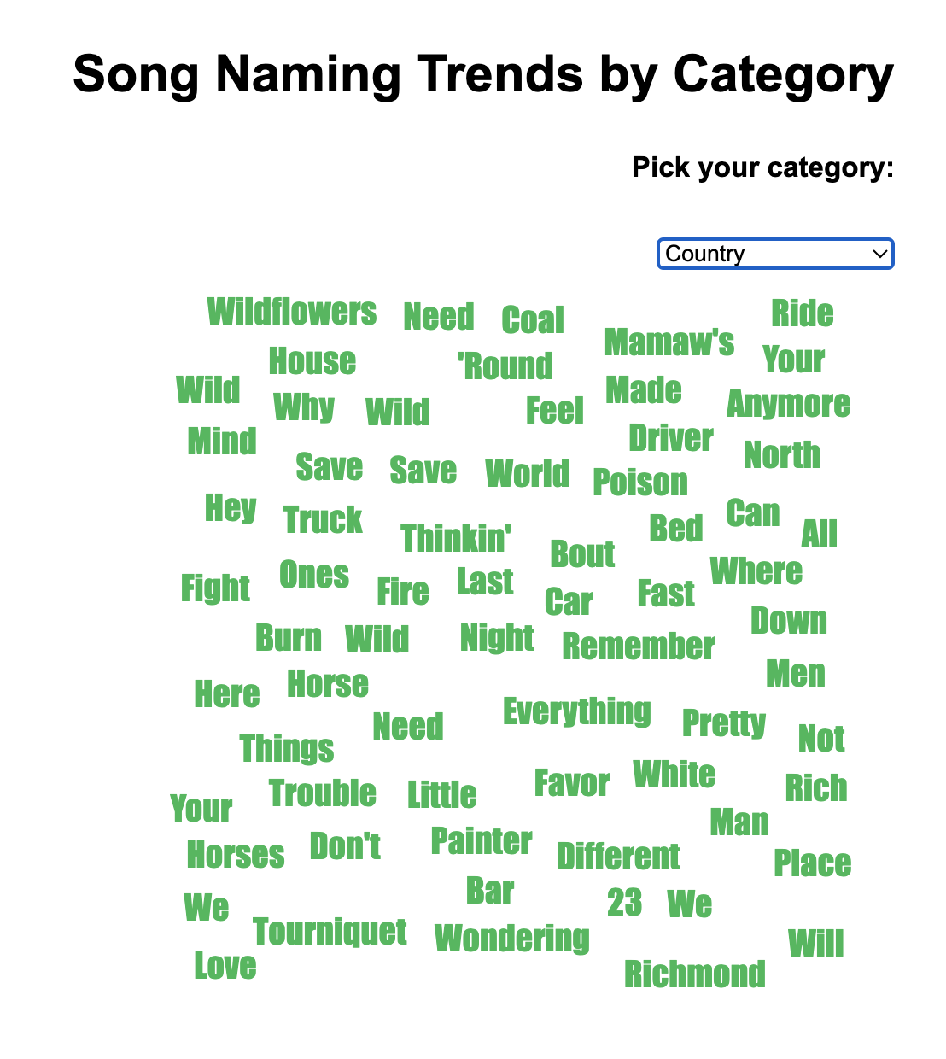
Naming Trends
Data
Data was taken from the categories table
Current top 40 songs by music category
Data visualization
D3 word cloud utilizing song titles
Common, nonmeaningful words were filtered out (”A”, “To”, etc.)
Filtered by music category
User interaction
User can choose which category they are interested in exploring

Slide 6
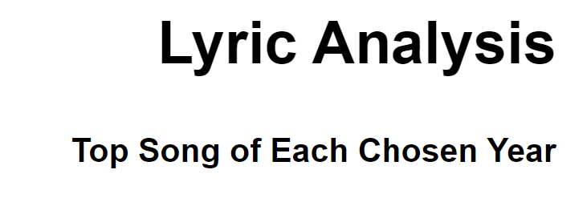
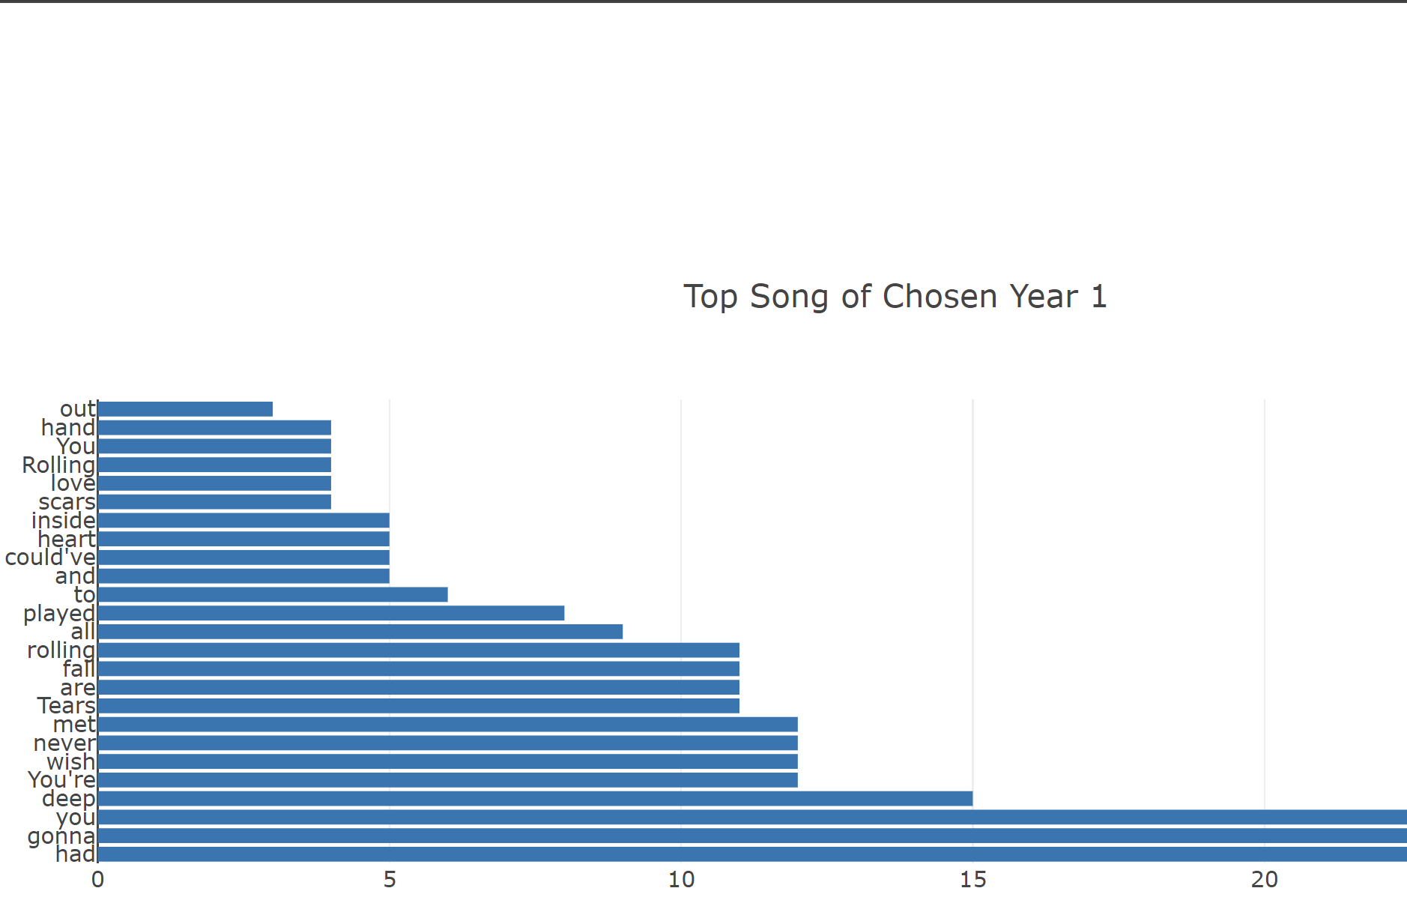
Lyric Analysis
Data
Data was taken from the top ten table.
Top song for the two chosen years.
Data visualization
Plotly horizontal bar chart of lyric frequency
Common, nonmeaningful words were filtered out (”A”, “To”, etc.)
Filtered to top 25 lyrics
User interaction
User chooses two years to compare

Slide 7
Future Avenues for Exploration
More years gathered for analysis
Search for the top 25 lyrics for the top 10 songs of the year
Music features analysis by albums

